Slide 1
From Views to Value: Leveraging Predictive Models to Decode YouTube Trends and Optimize Advertising Strategies
Team members -
Austin Serody
Praneeth Reddy
Shiva Praneeth Kodali
Balram Iyengar

Slide 2
Agenda
Introduction
05
Results & Conclusion
01
04
Predictive Models
Project Overview
02
03
Data Overview
Notes:
Purpose of the Project is to analyze YouTube data to identify key factors influencing video popularity in the US, using predictive models to help companies optimize advertising strategies.
The Scope of Project iis to analyze a dataset of trending YouTube videos using predictive modeling techniques to identify key factors influencing video popularity and provide actionable insights for optimizing advertising strategies.
Key Objectives:
What factors play a role in the popularity of YouTube videos in USA?
What video categories have the most view counts?
Does disabled engagement affect the popularity of a video?
How significant is the title length to the view count or popularity?
Based on the analysis, what strategy can an advertiser use to pick a YouTube video for advertising their product?

Slide 3
Data Overview
Description of the Dataset
The dataset contains several months of data on daily trending YouTube videos in the United States. This data was collected by YouTube, which was used to analyze the top trending videos for the year. The prominent independent variables are Published month, Tags, Video category, Title length, Published time., etc. The dependent variables are the view count and popularity of a video.
We aim to analyze the given dataset to determine the best possible combination of the above mentioned variables to produce a trending video on YouTube
Notes:
The data set we used has several months of data on daily trending youtube in United States.
The prominent independent variables are published month, tags, video category, title length & published time. Where as the dependent variables are the view count and popularity of a video.

Slide 4
Data Overview
Data Cleaning
Handling missing data
Missing data was found only in the video description column, this column is completely eliminated because the description of the video predominantly does not affect the view count.
Random sampling
As for random sampling, the original data set had around 40950 rows, from this a random dataset of 10000 rows was chosen using the RAND() function in excel. This is done to make sure there is a proper mix of high and low view count videos.
Notes:
While performing data analysis we did not find any missing data which effects the view count.
In our data set there are 40950 rows, we chose 10000 rows by using rand() function using excel. This was done to make sure of proper mixture of high and low view counts of videos.

Slide 5
Data Overview
Pre-Exploratory Analysis
Key Observations:
Variables: Numerical (views, likes) and categorical (month, category ID) variables analyzed.
Distribution of Views: Logarithmic transformation applied to normalize skewed views.
Category Analysis: Music, Comedy, and Gaming had the highest median views.
Correlations: Longer titles reduced views, more tags increased views.
Engagement Metrics: Disabled comments or ratings had minimal impact on views.
Outliers: High-performing outliers retained for analysis.
Notes:
Our exploratory data analysis focused on understanding the key variables and patterns in the dataset. We examined the distribution of views, applied a logarithmic transformation to handle skewness, and identified significant trends. Top categories like Music, Comedy, and Gaming stood out with the highest median view counts, while longer titles negatively impacted views. Engagement metrics like comments and ratings had minimal influence on popularity, and outliers, representing high-performing videos, were retained for meaningful insights. This analysis laid the foundation for building our predictive models.

Slide 6
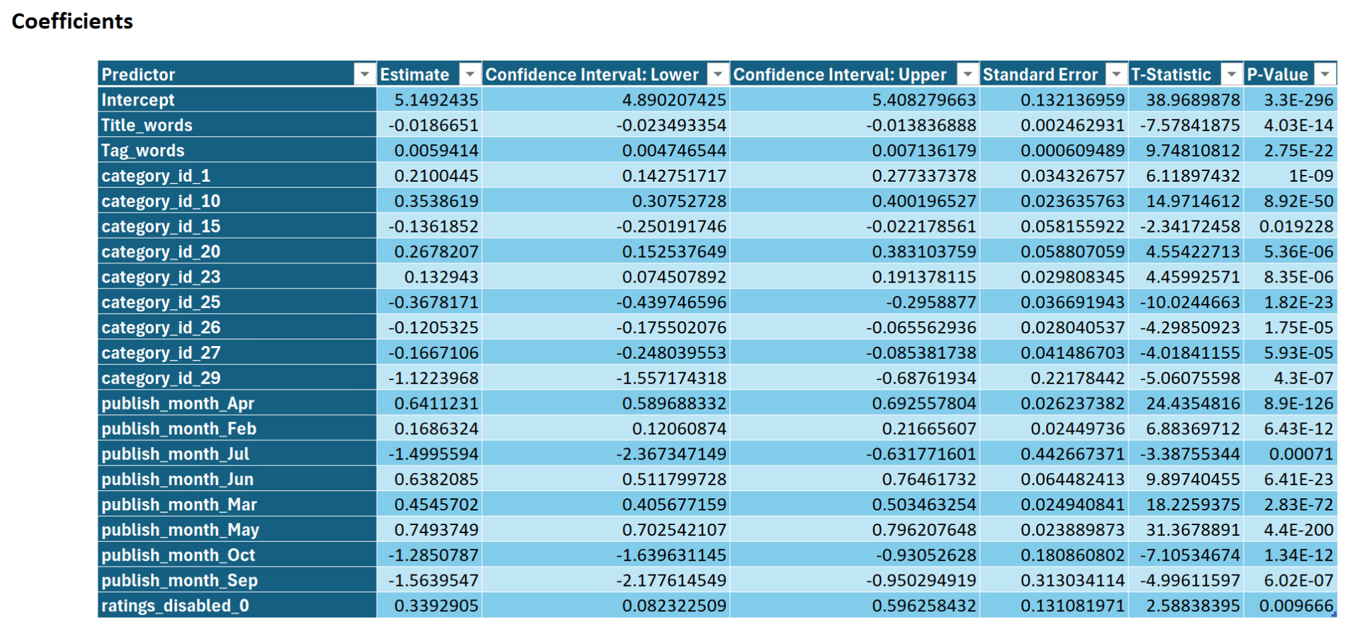
Predictive Model
Linear Regression
Notes:
Intercept: The baseline log-transformed view count is approximately 5.15 when all predictors are at zero.
Significant Predictors (p-value < 0.05):
Title Words: A negative coefficient (-0.0186) suggests that increasing the number of words in the title slightly reduces the view count.
Tag Words: A positive coefficient (0.0059) indicates that videos with more tags tend to have higher view counts.
Categories:
Category ID 10 (Music) has the strongest positive effect among categories, with a coefficient of 0.354.
Category IDs 15 (Pets & Animals) and 25 (News & Politics)** have negative effects, reducing view counts by 0.136 and 0.368, respectively.
Publish Month:
May (0.749) and April (0.641) contribute positively to view counts.
October (-1.285) and September (-1.564) have a significant negative impact.
Ratings Disabled (0.339): Videos with ratings enabled tend to perform better in terms of views.

Slide 7
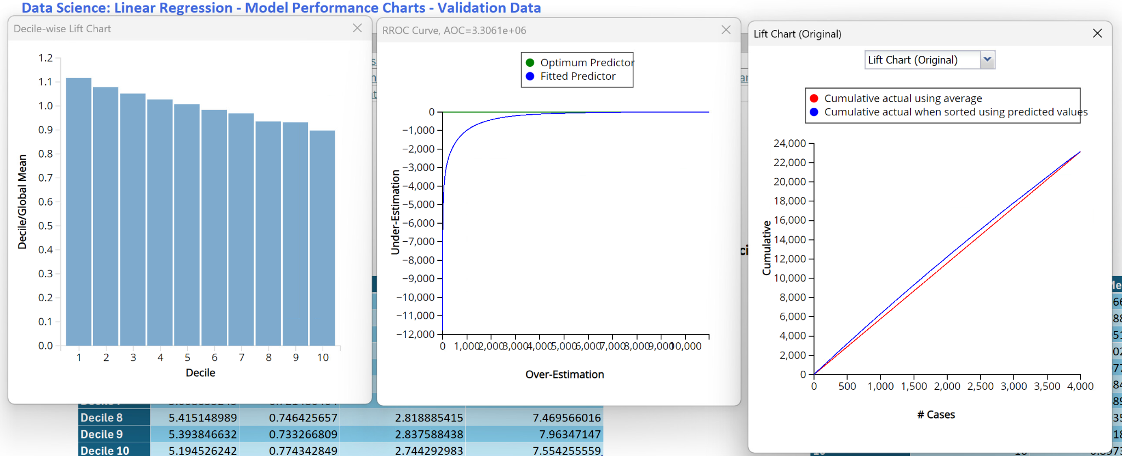
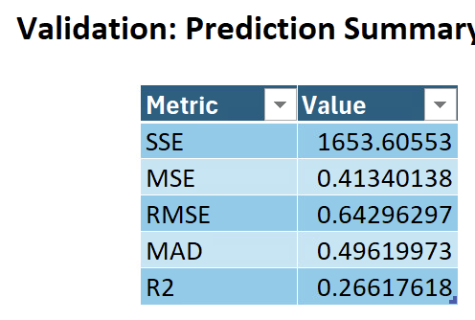
Predictive Model
Linear Regression
Notes:
Validation Data:
Lift Chart: Shows consistent performance with training data, indicating no overfitting.Near perfect AOC value.
ROC Curve (AOC ~3.31e+06): Maintains strong predictive performance on unseen data.
Interpretation of Results
Positive Predictors:
Videos in the Music category and those published in spring and summer months (April, May) are more likely to attract higher views.
More tags on videos improve discoverability and engagement.
Negative Predictors:
Longer titles reduce view counts, possibly due to reduced audience interest.
Certain categories (e.g., Pets & Animals, News & Politics) and months (e.g., October, September) are less favorable for view counts.
Business Implications
Video Creators:
Focus on publishing during high-view months (April–June) and utilize concise, engaging titles.
Maximize the number of tags to improve algorithmic visibility.
Advertisers:
Target videos in high-performing categories (e.g., Music) and during favorable months for maximum exposure.
Avoid advertising in low-performing categories and months.
The model’s performance, while strong, may not account for external factors (e.g., video quality, current trends).
Categorical predictors like category ID and month may have underlying interactions not captured in this model.

Slide 8
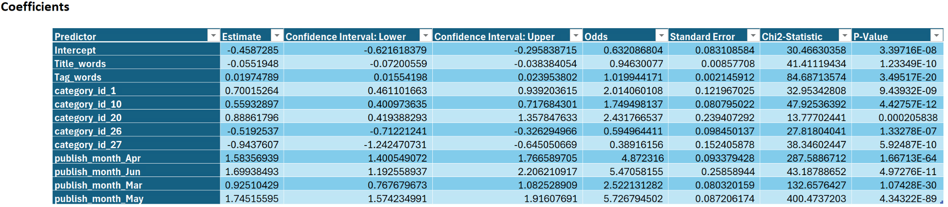
Predictive Model
Logistic Regression
Notes:
Intercept: Baseline odds of a video being popular is 0.63 (log-odds = -0.4587) when all predictors are at zero.
Let us look at Significant Predictors (p-value < 0.05):
Title Words:Coefficient is -0.0552 where as, looking at Odds, Videos with longer titles have slightly lower chances of being popular (Odds=0.946)
Tag Words:Coefficient is 0.0197 where as, looking at Odds, Videos with more tags are marginally more likely to be popular (Odds=1.02Odds)
In Categories:
Category ID 10 (Music) increases the likelihood of popularity by 75% (Odds=1.75)
Category ID 26 (How-To) reduces popularity by 40% (Odds=0.59)
Category ID 27 (Education) reduces popularity significantly by 61% (Odds=0.39)
Publish Month:
Videos published in May (Odds=5.72) and June (Odds=5.47) are much more likely to be popular compared to other months.

Slide 9
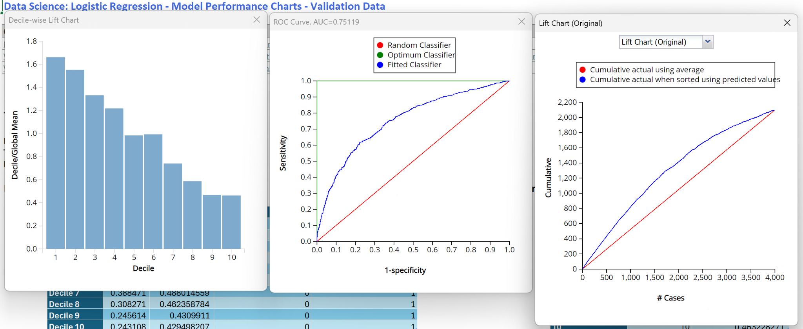
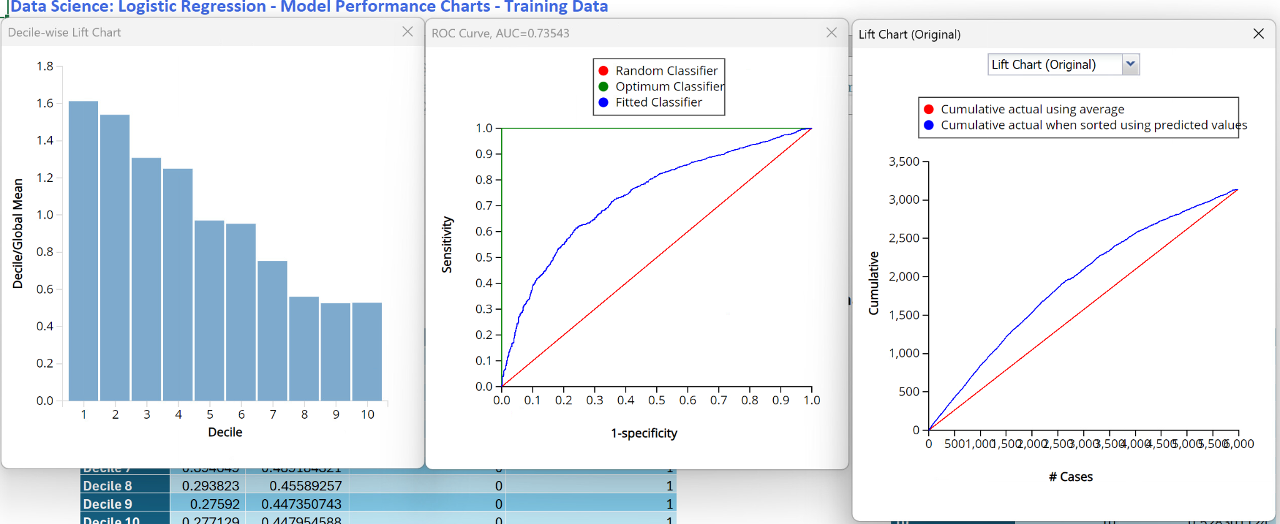
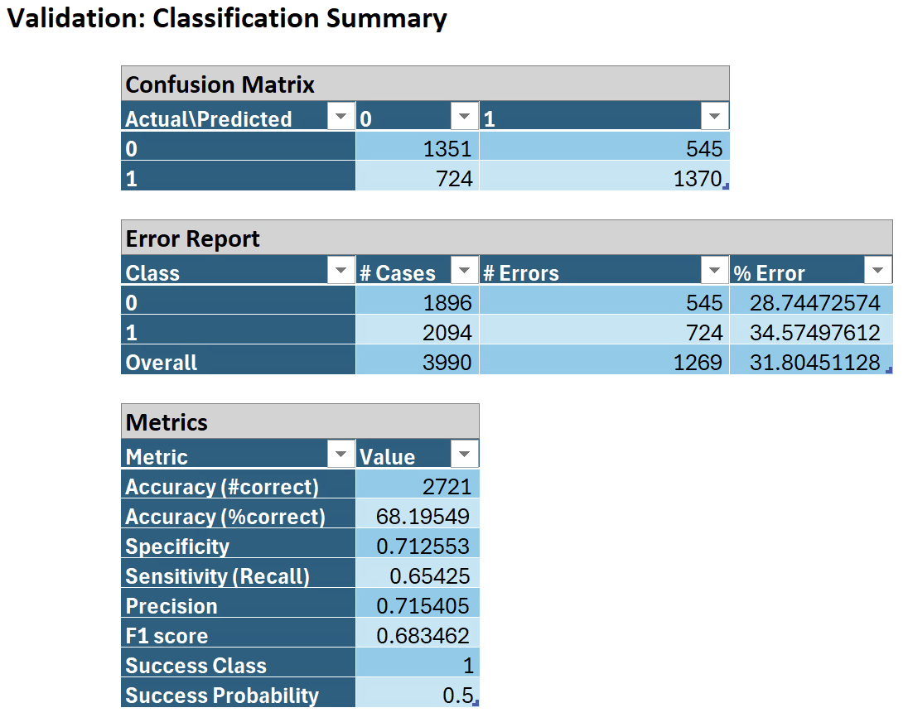
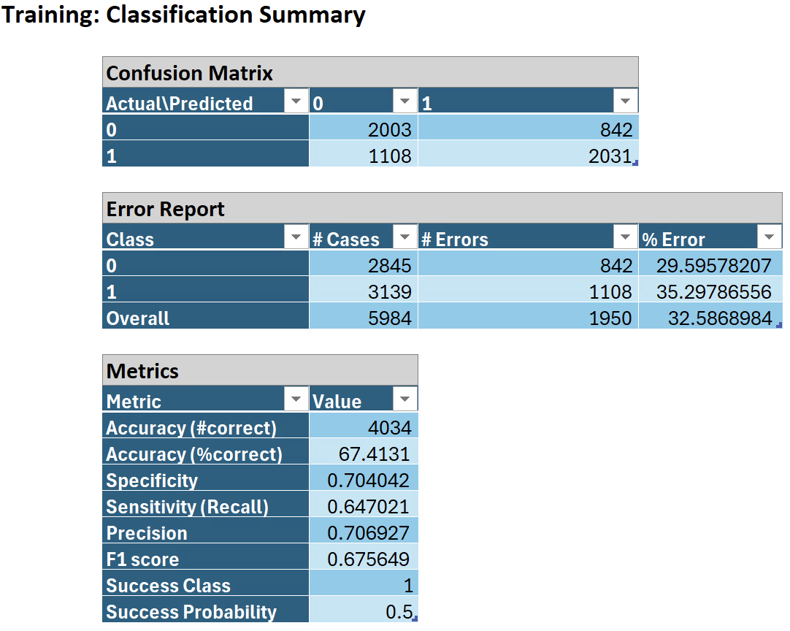
Predictive Model
Logistic Regression
Validation
Training
Notes:
Overall Model Effectiveness
Accuracy: Training Data is 67.4% and Validation Data is 68.2%. This indicates that the model predicts the class (popular or not popular) correctly for about 2 out of 3 cases in both training and validation sets, demonstrating a consistent performance across datasets.
In Area Under the Curve (AUC): Training Data is 0.735 and Validation Data is 0.751. When AUC values between 0.7 and 0.8 indicate that the model has good discriminatory power in distinguishing popular and non-popular videos.
High precision of 70.7%(training) & 71.5%(validation) implies that most of the videos the model predicted as popular were indeed popular.
Training: 64.7%
Validation: 65.4%
Moderate recall with 64.7% & 65.4%(training & validation) indicates the model successfully identifies a significant portion of actual popular videos but may miss some.
A balanced F1 score, 67.6% & 68.3% suggests the model is effective at predicting popular videos without being overly biased towards false positives or false negatives.
The model performs well, with consistent metrics across training and validation datasets, indicating good generalizability.
High precision and lift values make it effective for applications where correctly identifying popular videos is crucial (e.g., selecting content for advertisement).
Moderate recall suggests some room for improvement in capturing all popular videos.

Slide 10
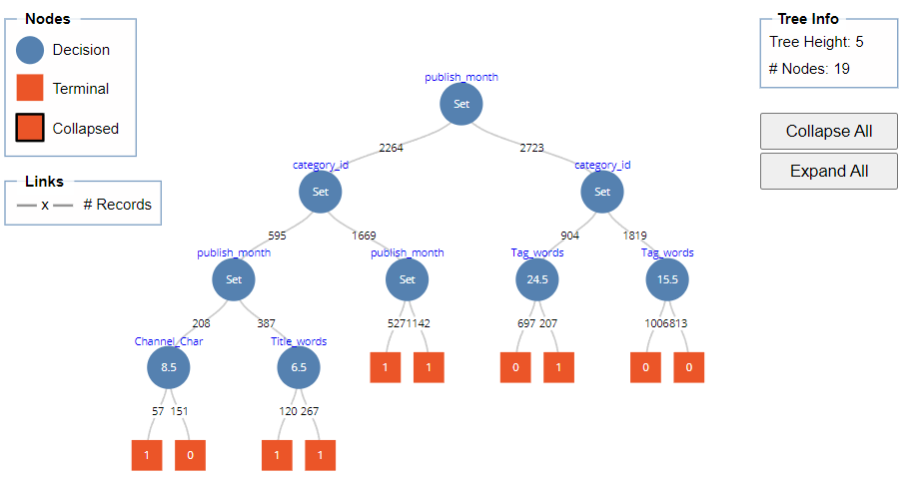
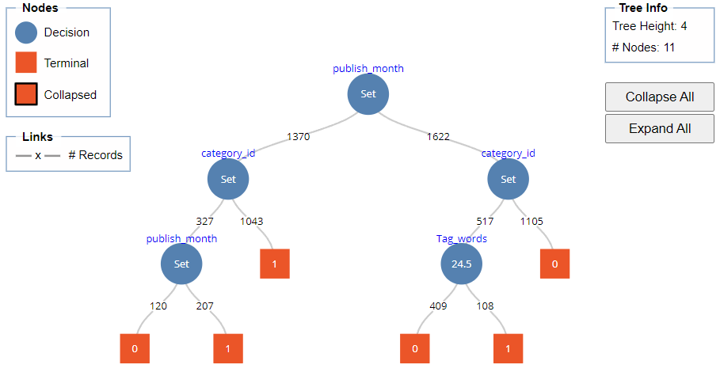
Predictive Models
Decision Tree
Full Tree
Best Tree
Notes:
Published Month and Category were the most significant predictors of video popularity.
Videos published in March, April, May, and June showed higher popularity.
Categories such as Music, Film, Gaming, Travel & Events, and Comedy were more likely to produce popular videos.
When Engagement was disabled (comments or ratings), did not significantly impact video popularity & Number of Tags was moderately important, with videos having more than 25 tags showing better popularity.
The length of the video title did not have a substantial effect on view counts.
For example, a video published in spring and early summer months and belonging to popular categories is predicted to be popular.
Videos from less popular categories or those published outside key months are less likely to trend unless supported by higher tags.
Achieved an overall accuracy of 69%, with an F1 Score of 68% and a good AUC (Area Under the Curve) of 72%.
Advertisers should target videos in popular categories published during high-traffic months to maximize reach and engagement.

Slide 11
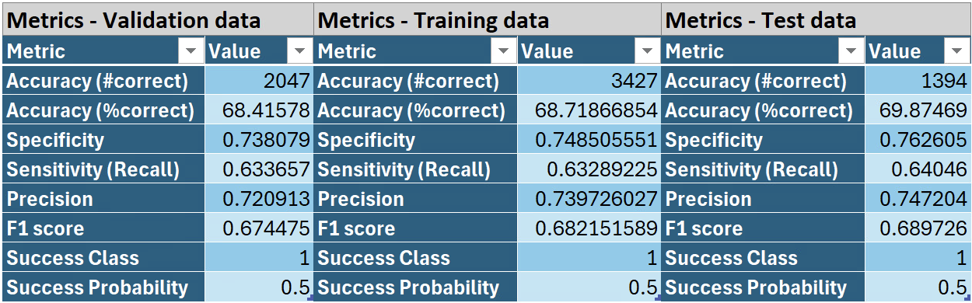
Predictive Models
Decision Tree

Slide 12
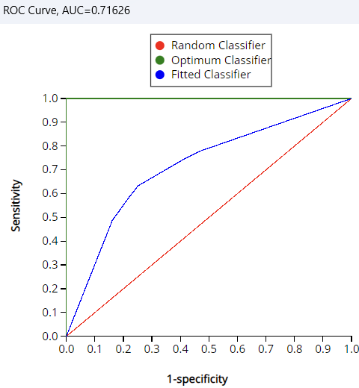
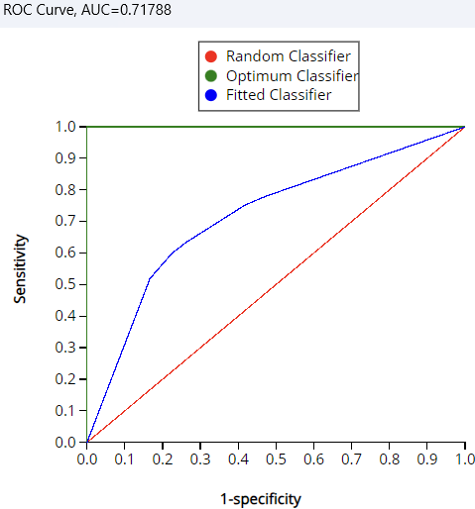
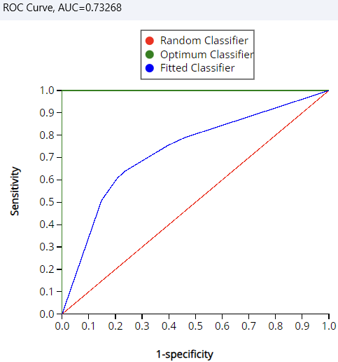
Predictive Models
Decision Tree
Training data
Validation data
Test data

Slide 13
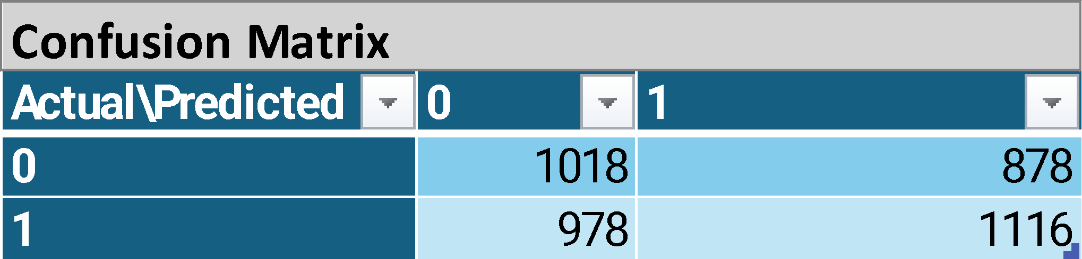
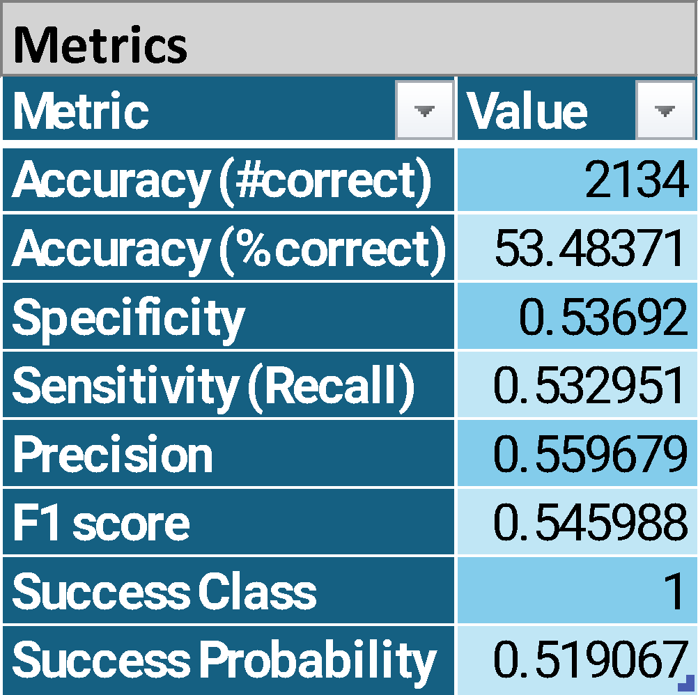
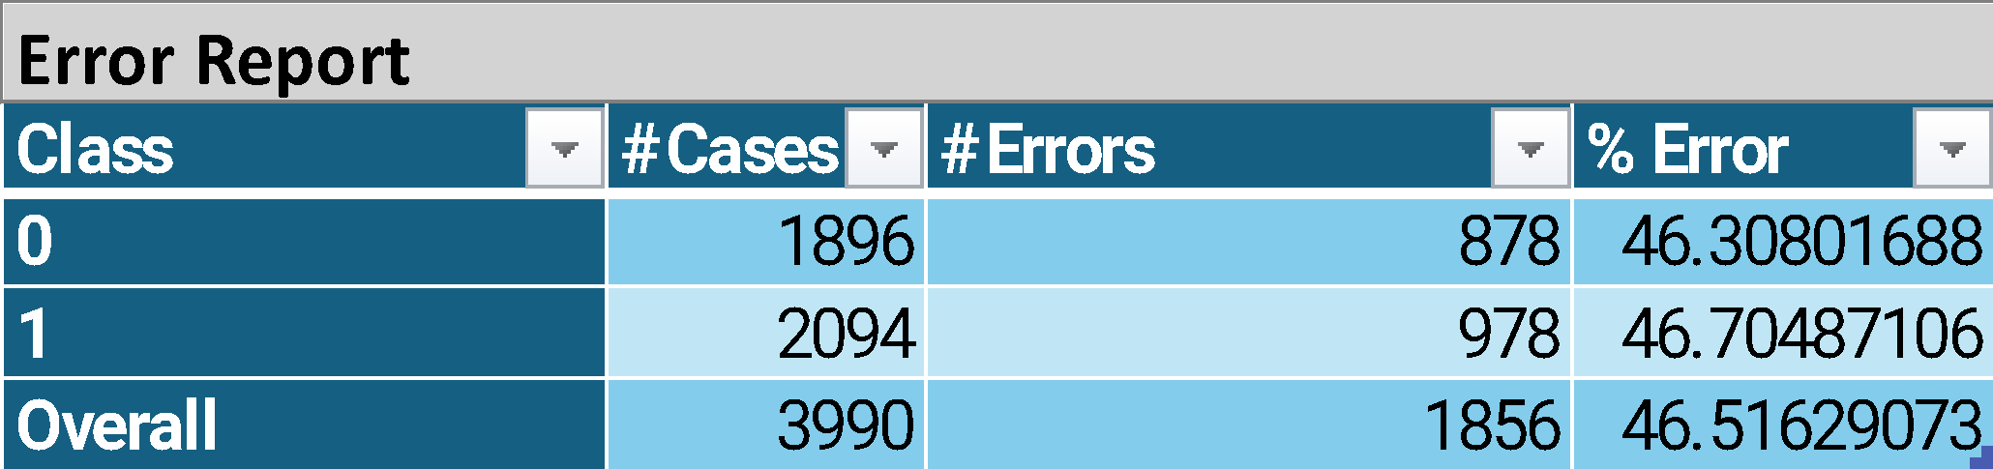
Predictive Model
Classification - Neural Network

Slide 14
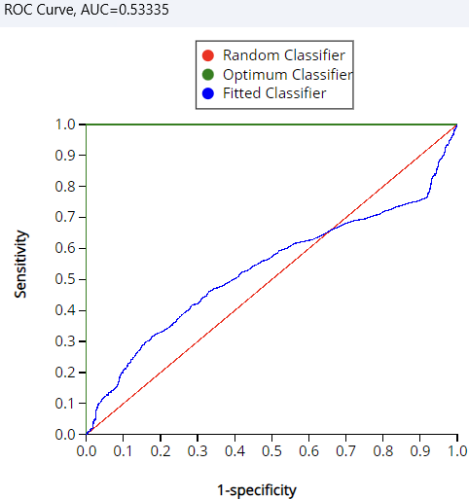
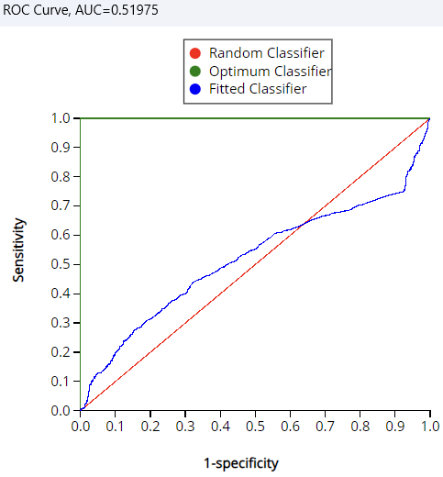
Predictive Model
Classification - Neural Network
Training data
Validation data

Slide 15
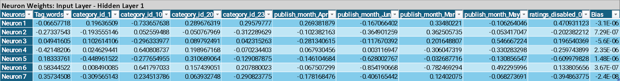

Predictive Model
Prediction - Neural Network

Slide 16
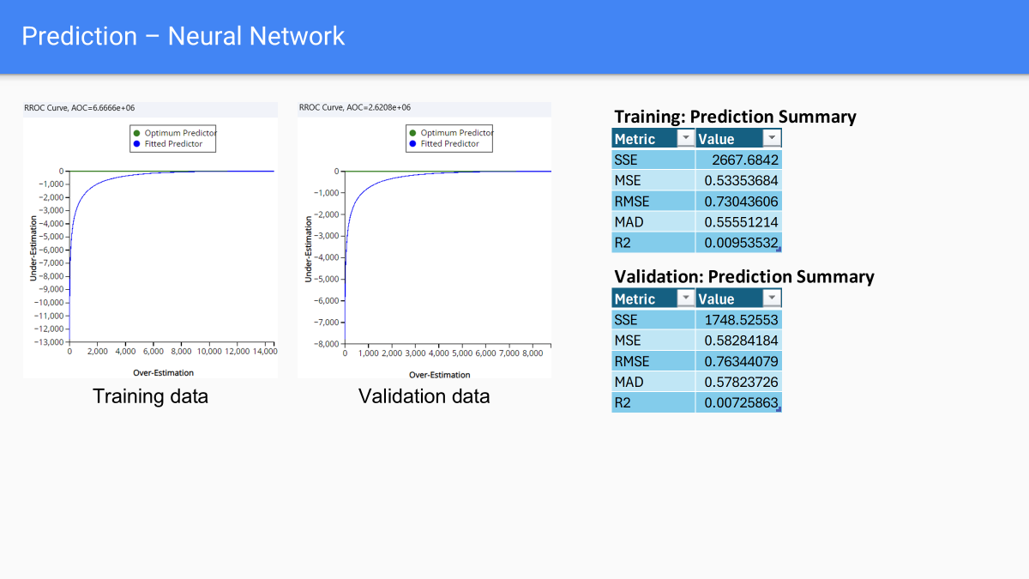

Slide 17
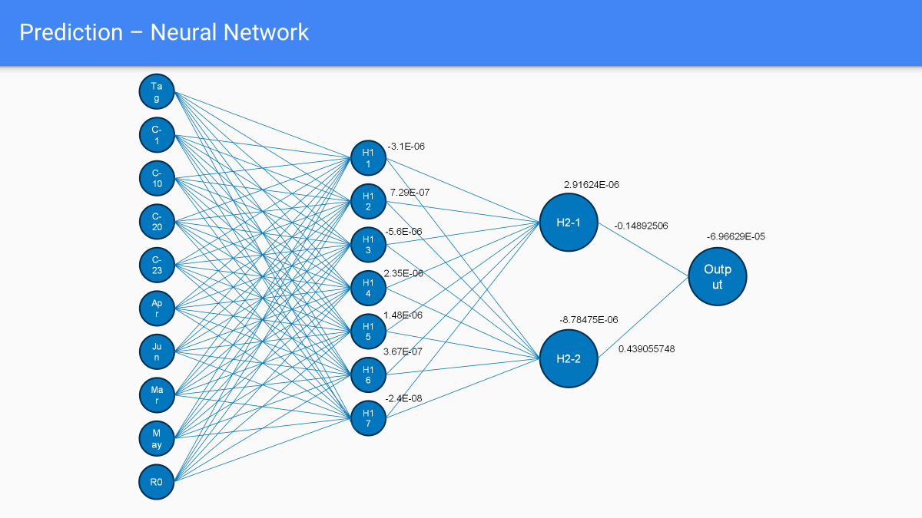

Slide 18
Final Models
Classifying video as popular:
Logistic Regression
Decision Tree
Predicting video view count:
Linear Regression
Neural Network

Slide 19
Conclusion
What factors affect how popular a YouTube video can be in the USA?
Published month, category, tags, title words
Which categories have the most views that could be used for advertising?
Music, film, gaming, travel & events, comedy
What strategy can an advertiser use to pick a type of YouTube video to
advertise their product on?
Advertise on videos
Published between March through June
Avoiding videos published during September and October
In categories music, film, gaming, travel & events, and comedy.
Avoid videos in categories pets & animals and news & politics
More tags in description but shorter titles

Slide 20

Thanks!

